Slide 1

Economic Integration
4.4
Copyright Bananaomics

Slide 2

How do you think countries start to trade? What do you think is the best way to increase trade?
Copyright Bananaomics

Slide 3
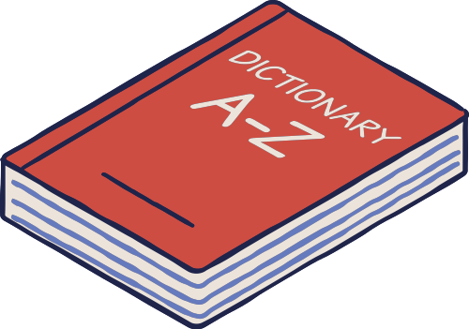
Definition
Economic Integration
Economic interdependence between countries usually involves agreements between two or more countries to phase out or eliminate trade and other barriers between them.
Copyright Bananaomics

Slide 4

Definition
World Trade Organization (WTO)
An international body that sets the rules for global trading and resolves disputes between its member countries. It also hosts negotiations concerning the reduction of trade barriers between its member nations.
Copyright Bananaomics

Slide 5
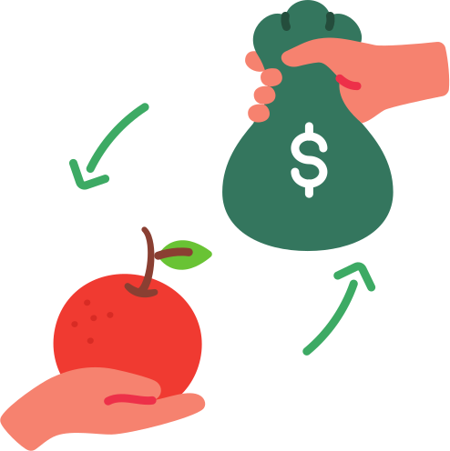
Preferential Trade Agreements (PTA)
Where a country agrees to give preferential access (for example, reduced tariffs) for certain products to one or more trading partners.
This is typically seen as the first stage of economic integration.
Copyright Bananaomics

Slide 6


Inquiry
Browse the list of PTA and define GSP
Copyright Bananaomics

Slide 7

Types of PTA
Unilateral
A country provides preferential tariff reductions for another without receiving the same treatment in return
Bilateral
An agreement between two countries to phase?out or eliminate trade related barriers
Multilateral
An agreement between many countries to lower tariffs or other protectionist measures, currently carried out within the framework of the WTO
Regional (RTA)
An agreement between a group of countries usually within a geographical region to lower or eliminate trade barriers
Copyright Bananaomics

Slide 8

Regional Trade Agreement
USMCA - Vox
Copyright Bananaomics

Slide 9

Trading Blocs
Copyright Bananaomics

Slide 10

Definition
Trading Bloc
A group of countries that have agreed to reduce protectionist measures like tariffs and quotas between them
Trading Blocs are a higher level of economic integration than PTA.
Copyright Bananaomics

Slide 11

4 Types of Trading Blocks
Free Trade Area
Customs Union
Common Markets
Monetary Union
Copyright Bananaomics

Slide 12

Free Trade Area (FTA)
An agreement between two or more countries to phase-out or eliminate trade barriers between them, members of the agreement are free to maintain their own trade policy towards non-members
Copyright Bananaomics

Slide 13

Examples
Click the link below and find a Free Trade Agreement (FTA) with you home country
Copyright Bananaomics

Slide 14
Free Trade Area Diagram
Embargo
Country A
Free Trade Area
Tariff
Country C
Country D
Free Trade Area
Free Trade Area
Country B
Free Trade
Copyright Bananaomics

Slide 15
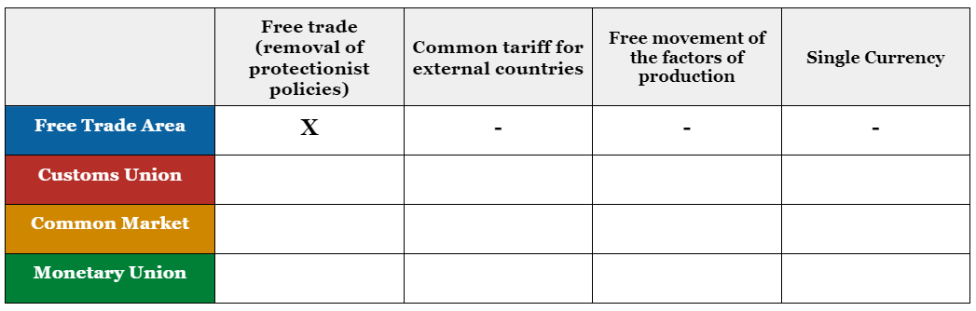
Free Trade Area (FTA)
Copyright Bananaomics

Slide 16

Customs Union
An agreement between countries to phase out or eliminate tariffs and other trade barriers and establish a common external barrier toward non-members.
Examples: EUCU, Southern African Customs Union (SACU), Eurasian Economic Union (EACU)
Copyright Bananaomics

Slide 17
Customs Union Diagram
Customs Union
Country A
Common External Policies
Free Trade Area
Country C
Country D
Country B
Copyright Bananaomics

Slide 18
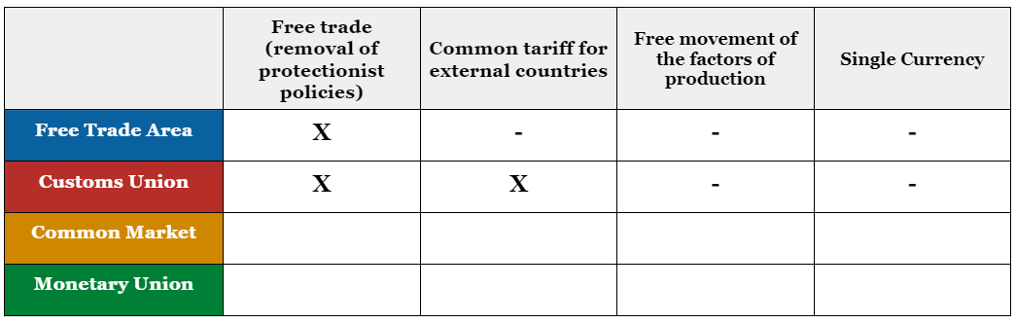
Customs Union
Copyright Bananaomics

Slide 19

Common Market
When a group of countries agree not only to free trade of goods and services but also to free movement of capital and labour.
Examples: European Union (EU)
Copyright Bananaomics

Slide 20
What is the EU?
The European Union Explained - CGP Grey
Copyright Bananaomics

Slide 21
Common Market Diagram
Common Market
Country A
Country C
Free Trade Area
&
Free Flow of FOP (Labor & Capital)
Common External Policies
Country D
Country B
Copyright Bananaomics

Slide 22
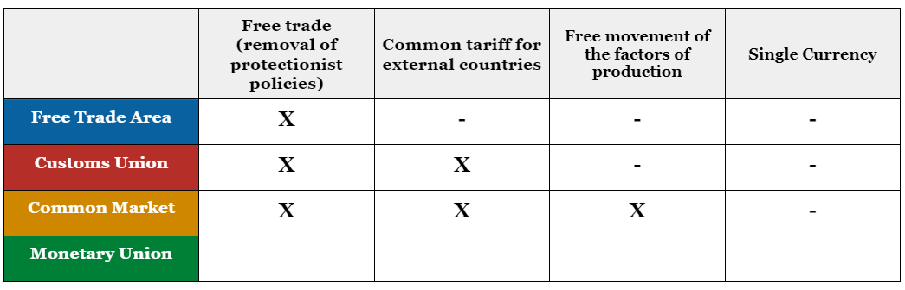
Common Market
Copyright Bananaomics

Slide 23
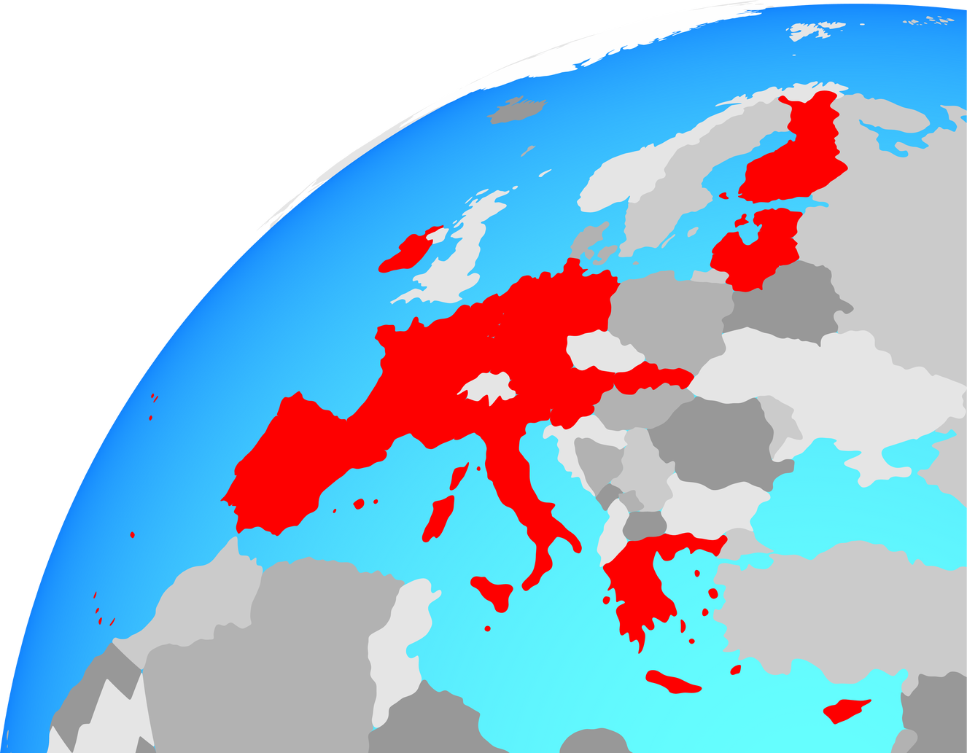
Monetary Union
Where two or more countries share the same currency and have a common central bank
Examples: The Euro Zone
Copyright Bananaomics

Slide 24
Monetary Union Diagram
Monetary Union
Country A
Free Trade Area
&
Free Flow of FOP (Labor & Capital)
&
Shared Currency
Country C
Common External Policies
Country D
Country B
Copyright Bananaomics

Slide 25
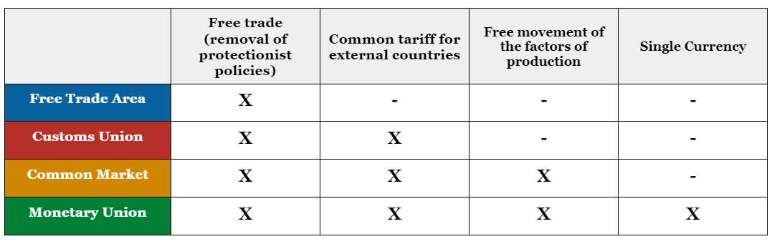
Monetary Union
Copyright Bananaomics

Slide 26

Trading Blocs Evaluation
Copyright Bananaomics

Slide 27

Trading Blocs Advantages
  Trade creation (HL only)
  Greater access to markets offer potential for economies of scale
  Freedom of labour, there are greater employment opportunities
  Membership in a trading bloc may allow for stronger bargaining power in multilateral negotiations
  Greater political stability and cooperation
Copyright Bananaomics

Slide 28

Trading Blocs Disadvantages
  Trade diversion (HL only)
  Loss of sovereignty
    Countries must cooperate or give up the idea of being fully independent and autonomous. For example, some countries in the EU are not in the Eurozone (shared currency zone) because they want to be able to control their money supply and most likely have some cultural connection to the currency.
  Challenge to multilateral trading negotiation
    Countries may have social, political, historical, and economic differences that make the development of trading blocs difficult.
Copyright Bananaomics

Slide 29

Trade Creation and Diversion
(HL ONLY)
Copyright Bananaomics

Slide 30

Trade Creation
When higher-cost imports are replaced by lower-cost imports due to the formation of a trading bloc or a trade agreement
The hope of trading blocs is that domestic industries can lower their production costs thanks to the agreement.
Example: When a country joins the EU, they gain new opportunities for trade at cheaper prices.
Copyright Bananaomics

Slide 31

Trade Diversion
When lower-cost imports are replaced by higher-cost imports due to the formation of a trading bloc or a trade agreement.
When joining a trading bloc, a country must use the same protectionist policies as other members. Therefore, if a country has received low-cost imports from a country but now must erect trade barriers against them, the cost of the imports increase.
Copyright Bananaomics

Slide 32

Evaluation of Monetary Unions
(HL ONLY)
Copyright Bananaomics

Slide 33

Monetary Union Advantages
  Strong relations between countries
  Price stability
  Ease of payment (Exports & Imports)
  No currency exchange fees lead to more competition in business
  Global power and trade
Copyright Bananaomics

Slide 34

Monetary Union Disadvantages
  Political Issues
  Lack of sovereignty in currency
  Unable to control/use Monetary Policy
  Limitations on Fiscal Policy
  Large cost to transition new countries into the Monetary Union
Copyright Bananaomics

Slide 35

The World Trade Organization
Copyright Bananaomics

Slide 36

Definition
World Trade Organization (WTO)
An international body that sets the rules for global trading and resolves disputes between its member countries. It also hosts negotiations concerning the reduction of trade barriers between its member nations.
Copyright Bananaomics

Slide 37

The WTO
Objective
To help trade flow smoothly, freely, and predictably.
Copyright Bananaomics

Slide 38
The WTO
Functions
  Administering WTO trade agreements
  Forum for trade negotiations
  Handling trade disputes
  Monitoring trade policies
  Technical assistance and training for developing economies
  Cooperation with other international organizations
Copyright Bananaomics

Slide 39

The WTO
Principles
  Non-discrimination
  Openness of trade: lowering all trade barriers among nations
  Predictability and transparency
  Promotion of fair competition: this principle attempts to assess the fairness of trade transactions and responses
  Privileging less developed countries: this is aimed at improving equity between more developed countries (MDC) and less developed countries (LDC)
  Protecting the environment
Copyright Bananaomics

Slide 40

Factors Affecting the Influence of The World Trade Organization
Copyright Bananaomics

Slide 41

Unequal Bargaining Power
More Developed Countries (MDCs), are able to send delegates and representatives to the WTO regularly leading to them potentially receiving preferential treatment.
World trade leaders like the EU, USA, China, etc. have significantly more power when negotiating.
Copyright Bananaomics

Slide 42
How the US obstructs the World Trade Organisation - DW News
Copyright Bananaomics

Slide 43

Disputes Over Primary Products
Disputes over agricultural goods are frequent at the WTO. Developed countries offer large subsidies in agriculture driving down price while developing countries lack subsidies and cannot compete in the international agricultural market.
MCDs also prefer to receive raw materials rather than processed materials, leading to difficulties for countries that are trying to develop as they have little incentive to improve industries to offer processed goods.
Copyright Bananaomics

Slide 44
Is the WTO still needed? | DW English
Copyright Bananaomics

Slide 45

Practice Question
Copyright Bananaomics

Slide 46
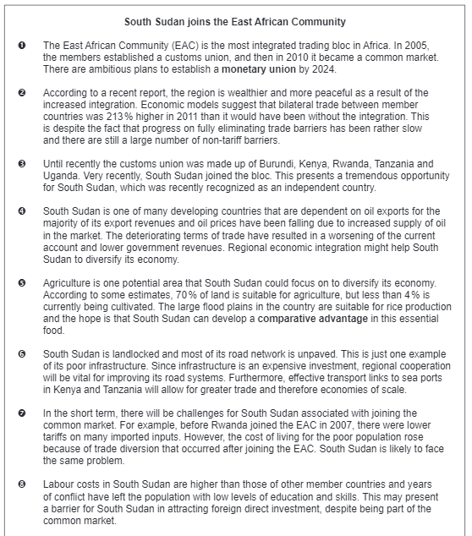
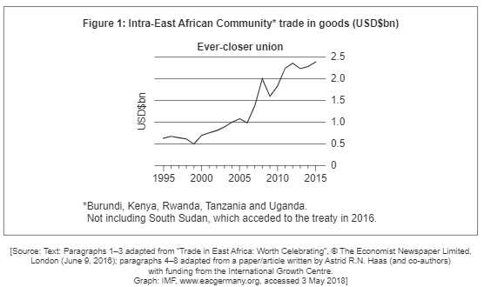
Paper 2
N18/3/ECONO/HP2/ENG/TZ0/XX
Copyright Bananaomics

Slide 47
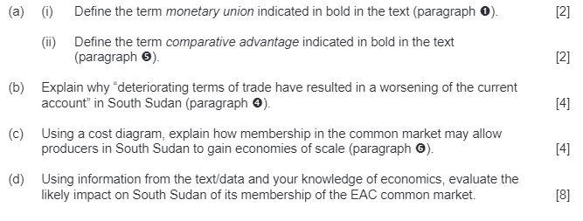
Paper 2
N18/3/ECONO/HP2/ENG/TZ0/XX
Copyright Bananaomics

Slide 48
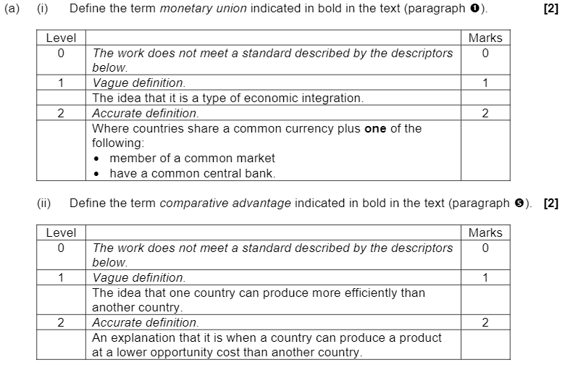
Mark Scheme
Copyright Bananaomics

Slide 49
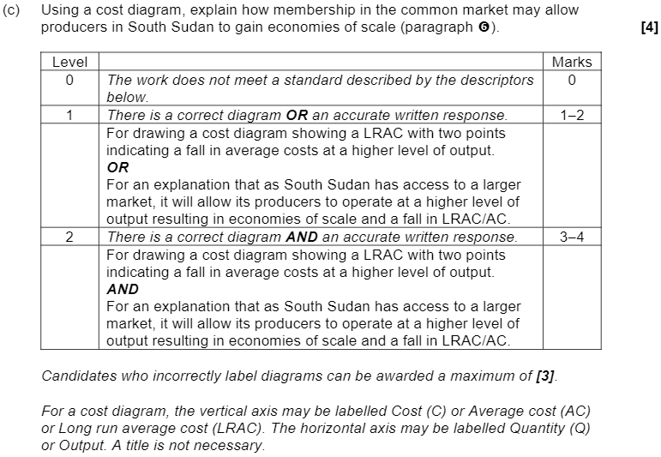
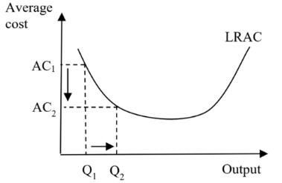
Mark Scheme
Copyright Bananaomics

Slide 50
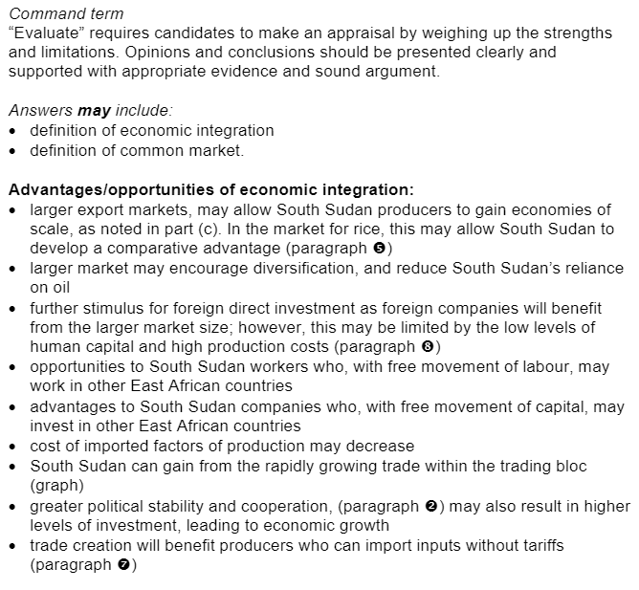
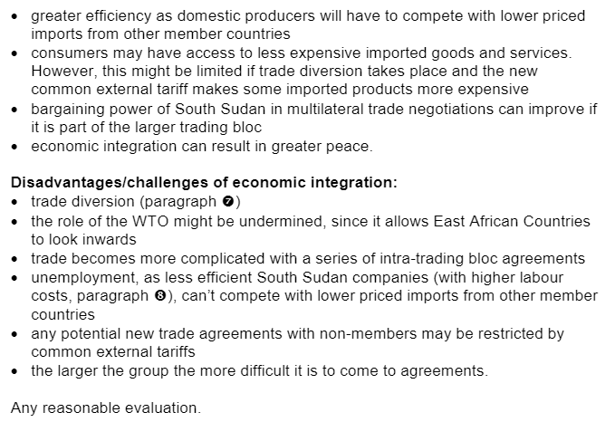
Mark Scheme
Copyright Bananaomics

Slide 51

Enjoying The Content?
Visit bananaomics.com to purchase package deals with discount prices!
BANANAOMICS

